Slide 1
Face Recognition Based – Smart Attendance System

Slide 2
Abstract
Authentication is one of the significant issues in the era of information system. Among other things, human face recognition (HFR) is one of known techniques which can be used for user authentication. However, it is difficult to estimate the attendance precisely using each result of face recognition independently because the face detection rate is not sufficiently high.
Finally, experiments are implemented to provide as evidence to support our plan. The result shows that continuous observation improved the performance for the estimation of the attendance.

Slide 3
Problem Statement
Smart Attendance and Class Monitoring System
Chronic absenteeism is a problem in schools during the best of times, but now, with the vast majority of the nation’s school buildings closed due to COVID-19, lessons being conducted remotely, more students than ever are missing class — logging in, but not being mentally present.
To have a check, on whether students are actively participating in the classroom, there is a need to check their activity during the class.

Slide 4
Approach
Face, uniquely identifies a person . Using the facial characteristics as biometric, the face recognition system can be implemented which can be used for the most demanding task in any organization i.e. Attendance marking.
In the solution we have come up with, it involves, monitoring the student though the camera throughout the class. We will track the student’s face and his eye moments if he is playing attention and looking at the screen.
We are going to implement this using some Libraries written below:
face recognition,
cv2 (OpenCV),
NumPy dlib

Slide 5
Advantages
The system stores the faces that are detected and automatically marks attendance.
Ease of use is manipulate and recognize the faces in real time using. Multiple face detection. Multipurpose software Can be used in different places.
By forcing the student out of his laziness to attend the class, he will be benefitted if he properly pays attention in the class. For teachers, they don't have to use the class time to check who is present or absent. They can give more time to their studies. This way both are benefitted.

Slide 6
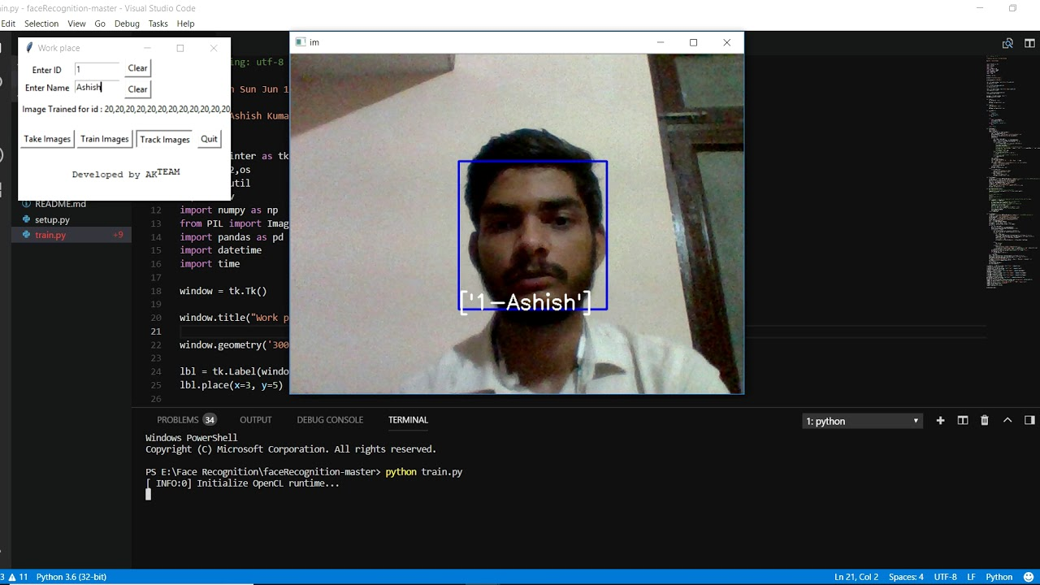
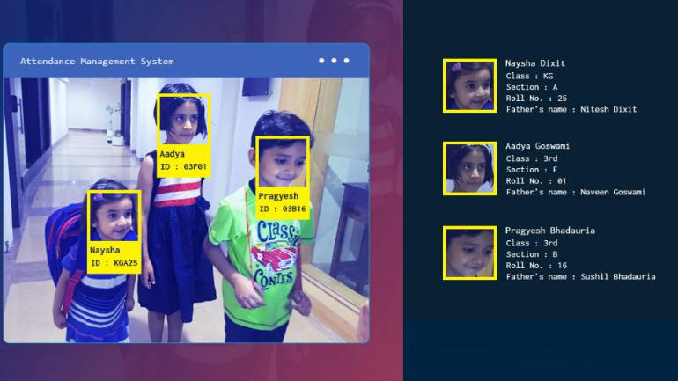
Practical Application
We seek to provide a valuable attendance service for both teachers and students. Reduce manual process errors by providing automated and a reliable attendance system that uses face recognition technology.

Slide 7
FACE RECOGNITION AND CAPTURING

Slide 8
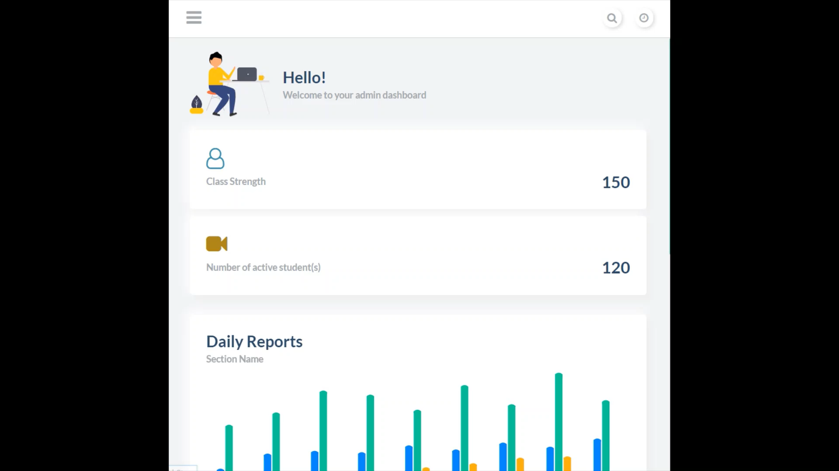
WEBSITE DEMONSTRATION

Slide 9




TECH STACK

Slide 10
Future work & Scaling
We seek to provide a portable solution i.e. it can be easily deployed on the student’s computer without taking much of the resources.
It will be linked to a WebApp, which will display live results of students
Name and number of students currently attending the class (whose face is visible)
The duration for which their faces were visible
Number of times they averted their eyes from the screen and for how long.

Slide 11


Future Ideas We have other ideas that can be implemented with the current solution such as:
If the student is taking notes or not with the help of object detection.
Detecting if assignments were copied by examining the contents of the assignment via OCR.
Planning to shift the entire software to Cloud so as to ensure better availability.

Slide 12
THANKS!
Any questions?
<Binary Threat>
Team Members
Salokya Kumar 1905340
Snehasish Sameer Sourav 1905356
Rohit Jaiswal 1929235
Abhishek Dutt 1905294

